Slide 1
Department of Computer Science and Engineering
JAWAHARLAL NEHRU TECHNOLOGICAL UNIVERSITY HYDERABAD UNIVERSITY COLLEGE OF ENGINEERING
Kukatpally, Hyderabad, Telangana(India) – 500 085
DISSERTATION WORK REVIEW-I AUGUST-2026
POST-QUANTUM SECURE FILE ENCRYPTION USING ML-KEM-512 AND AES-256-GCM
Presented by:
Matam Manasa(22011P0547)
B.Tech + M.Tech : V-I Semester
CSE-IDP
Under the Guidance of: Dr. Eedi Hemalatha Professor Department of Computer Science and Engineering

Slide 2
j
ABSTRACT
Quantum computing may pose future security challenges to conventional public-key cryptographic algorithms such as RSA (Rivest–Shamir–Adleman) and ECC (Elliptic Curve Cryptography), creating concerns for the long-term protection of sensitive files. To address this, the project proposes a Post-Quantum Cryptography (PQC) based hybrid file-encryption system. ML-KEM-512 (Module-Lattice-Based Key-Encapsulation Mechanism) will be used for quantum-resistant key establishment, HKDF-SHA256 (HMAC-based Key Derivation Function with SHA-256) for encryption key derivation, and AES-256-GCM (Advanced Encryption Standard in Galois/Counter Mode) for file encryption and authentication. The system will be implemented as a file-encryption and decryption prototype and evaluated for functional correctness, tamper detection, encryption and decryption time, throughput, memory usage, and performance overhead. The project aims to provide a practical approach for protecting sensitive files against future quantum-related threats.

Slide 3
j
Problem Statement
1. RSA and ECC may be broken in the future
Today, we commonly use RSA and ECC for secure communication.
But powerful quantum computers could potentially break these algorithms in the future.
2.Sensitive encrypted data can face “harvest now, decrypt later” attacks.
3. PQC is needed
Post-Quantum Cryptography.
PQC provides cryptographic algorithms designed to remain secure against attacks from quantum computers.
4.Therefore, there is a need for a hybrid file-encryption system that combines post-quantum key establishment with efficient authenticated symmetric encryption.

Slide 4
j
Existing System
RSA and ECC are commonly used for public-key cryptographic operations.
Advanced Encryption Standard(AES) is widely used to encrypt the actual file because it is efficient for large amounts of data.
The problem is that RSA and ECC may face threats from future quantum computers.
Post-Quantum Cryptography (PQC) provides cryptographic approaches designed to resist quantum attacks.
A hybrid approach is therefore relevant: PQC for key establishment + AES for bulk file encryption.

Slide 5
j
Motivation
Quantum computing is developing Future quantum computers may create security problems for conventional public-key cryptography like RSA and ECC.
Sensitive files need long-term protection Some files need to remain confidential for many years.
We need to prepare for PQC Since quantum computing is developing, it is important to start using Post-Quantum Cryptography (PQC).
We need both security and efficiency We want quantum-resistant key establishment and fast encryption of large files.

Slide 6
sj
Proposed Solution
Develop a hybrid post-quantum file-encryption system.
1. ML-KEM-512 Used for post-quantum key establishment.
2. HKDF-SHA256 Derives the encryption key from the ML-KEM-512 shared secret.
3. AES-256-GCM Encrypts the actual file and provides authentication/tamper detection.
Integrate these components into a single file-encryption and decryption prototype.
Evaluate the system for security functionality and performance overhead.

Slide 7
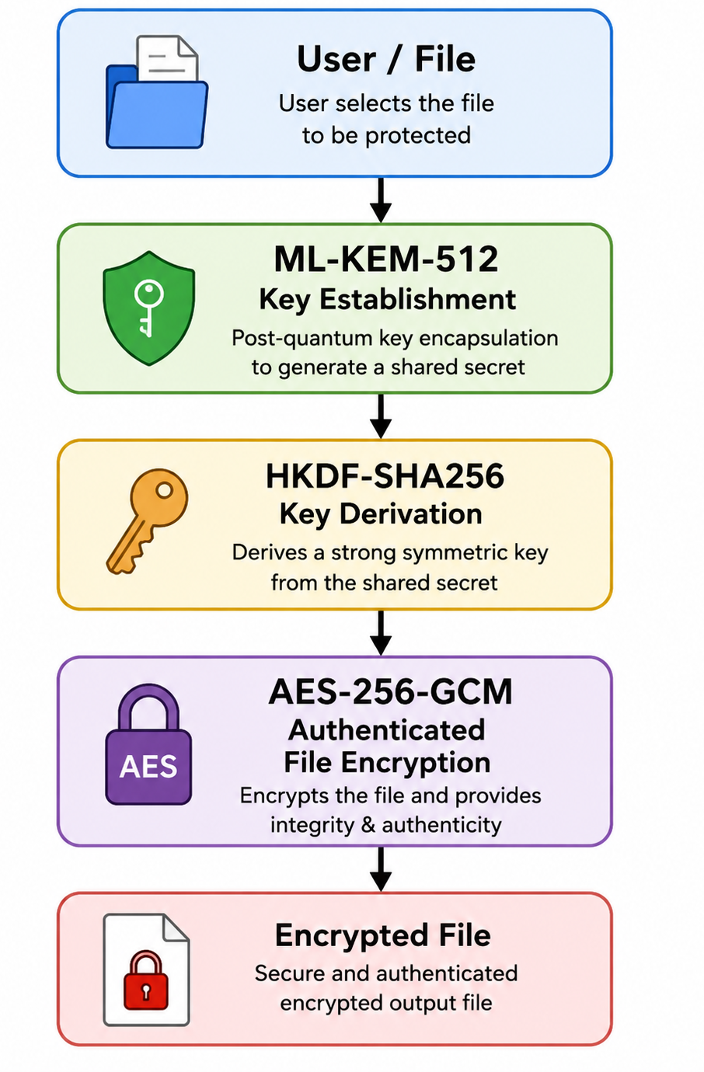
ARCHITECTURE
The proposed system uses ML-KEM-512 for post-quantum key establishment, HKDF-SHA256 for deriving the encryption key, and AES-256-GCM for secure and authenticated file encryption.

Slide 8
Algorithms
1. ML-KEM-512
Module-Lattice-Based Key-Encapsulation Mechanism
A Post-Quantum Cryptography (PQC) algorithm standardized by NIST.
Used for secure key establishment, not for encrypting large files.
Provides a shared secret between the communicating parties.
2. HKDF-SHA256
HMAC-based Key Derivation Function
A key derivation function (KDF) used to derive cryptographic keys from shared secret material.
Converts the ML-KEM shared secret into suitable key material for symmetric encryption.
Derives the AES-256 encryption key from the shared secret
3. AES-256-GCM
Advanced Encryption Standard – Galois/Counter Mode
Authenticated symmetric encryption algorithm.
Uses a 256-bit key for file encryption.
Provides confidentiality and integrity/authentication.
Detects unauthorized modification of encrypted data

Slide 9
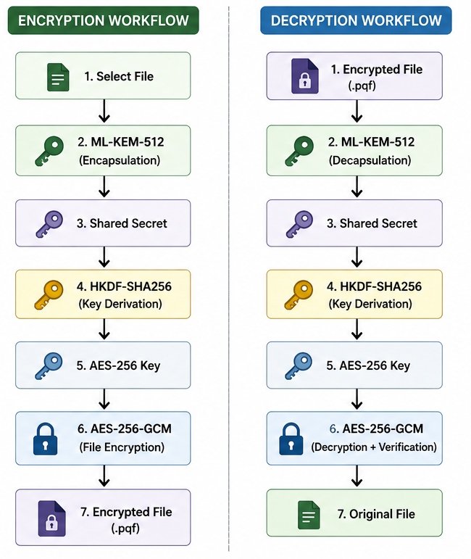
Proposed System Workflow
The proposed workflow will provide secure file encryption, decryption, and integrity verification.
Use two flows:
Encryption Workflow
Decryption Workflow
The proposed workflow combines post-quantum key establishment with symmetric authenticated encryption for secure file protection.

Slide 10
What exactly will I do to build this project?
Proposed Implementation
Phase 1 — Cryptographic Setup
We will implement:
ML-KEM-512 → Key establishment
HKDF-SHA256 → Key derivation
AES-256-GCM → File encryption
Phase 2 — Application Development
We will develop an application for:
File selection
File encryption
File decryption
Secure key handling
Basic GUI

Slide 11
Phase 3 — Integration
We will integrate:
ML-KEM-512 + HKDF-SHA256 + AES-256-GCM
into a single file-encryption and decryption system.
Phase 4 — Testing
We will test:
Encryption
Decryption
Original file recovery
Tamper detection

Slide 12
Evaluation Plan
1. Functional Evaluation
Encryption correctness
Decryption correctness
Original file recovery
Tamper detection
2. Performance Evaluation
Encryption time
Decryption time
Throughput
Memory usage
3. Comparative Evaluation
AES-256-GCM
ML-KEM-512 + HKDF-SHA256 + AES-256-GCM
4. Test Data
Different file sizes
5. Security Evaluation
Confidentiality
Integrity / authentication
Key-establishment security
Resistance to unauthorized modification

Slide 13
Expected Outcome
Working file encryption and decryption prototype
Post-quantum key establishment using ML-KEM-512
Secure and authenticated file encryption using AES-256-GCM
Tamper detection for modified encrypted files
Performance comparison with conventional AES-256-GCM
Assessment of performance overhead introduced by the hybrid approach

Slide 14
Conclusion
The project proposes a post-quantum secure file-encryption system.
ML-KEM-512 will be used for quantum-resistant key establishment.
HKDF-SHA256 will derive the encryption key.
AES-256-GCM will provide efficient file encryption and integrity protection.
The proposed system will be implemented and evaluated for security functionality and performance.
Conclusion
The project proposes a post-quantum secure file-encryption system.
ML-KEM-512 will be used for quantum-resistant key establishment.
HKDF-SHA256 will derive the encryption key.
AES-256-GCM will provide efficient file encryption and integrity protection.
The proposed system will be implemented and evaluated for security functionality and performance.

Slide 15
THANK YOU

